Slide 1
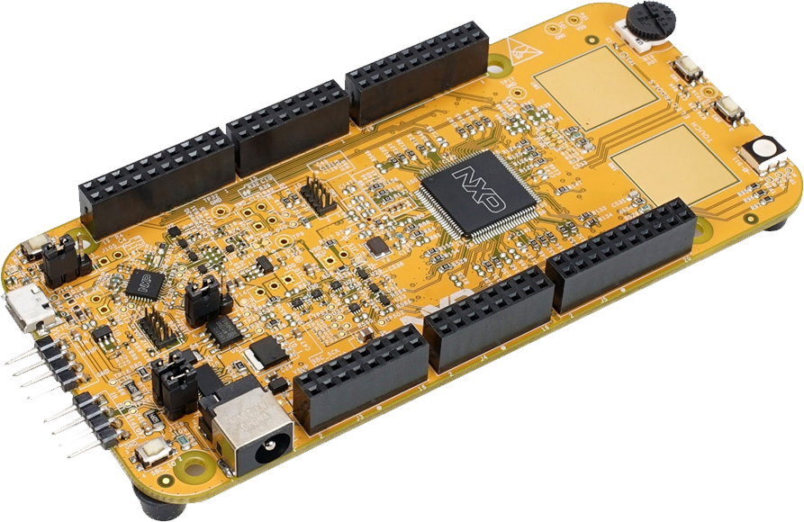
MOCK
Project
Report
28 Dec 2023

Slide 2
OUTLINE
Input
2. Requirement
3. Connection diagram
4. Analyze requirement
5. Algorithm

Slide 3
1. Input
Hardware:
- 2 buttons(onboard):
+ BT1(PTC12).
+ BT2(PTC13).
- 1 8-digit seven-segment LED display.

Slide 4
2. Requirement
Write program: The Digital Clock
SRS 1: After power on, display the time: 00-00-00 (date: 01.01.1971) SRS 2: Press Button 1 - SRS 2-1: Display the date - SRS 2-2: Display the time SRS 3: Press Button 2 - SRS 3-1: Turn off the display mode - SRS 3-2: Turn on the display mode SRS4: Setting date, time by UART serial communication SRS5: Use potentiometer to control the brightness of LED display(Opt)

Slide 5
3. Connection diagram
S32K144EVB
BUTTON2
PTC13
PTB16
DIN
8-digit seven-segment
LED display
PTB14
CLK
BUTTON1
PTC12
PTB17
CS
Connection Diagram

Slide 6
4. Analyze requirement
SRS 1: After power on, display the time: 00-00-00 (date: 01.01.1971)
Reset
Time=00-00-00
Date=01.01.1972

Slide 7
4. Analyze requirement
SRS 2: Press BT1
SRS 2-1: Display the date (01.01.1972).
SRS 2-2: Display the time (00-00-00).
Display the date
Display the time
Display= {Time, Date }

Slide 8
4. Analyze requirement
SRS 3: Press BT2
SRS 3-1: Turn off the display mode.
SRS 3-2: Turn off the display mode
Turn on
Turn off
Mode= {ON, OFF }

Slide 9

4. Analyze requirement
SRS 4: Setting date, time by UART serial communication
Send string by UART
06201028102023
Display the date
Display the time

Slide 10
5. Algorithm
Main Task
Start
(1) Buttons Initialization
(2) Led display Initialization
(3) Display the time
(4) Send command to display Led
(5) Wait a second
(6) Processing the next mode
10

Slide 11
5. Algorithm
(1) Buttons Initialization
Begin Buttons Initialization
Enable clock for PORTC
Set pins as GPIO function
Disabled pull-up/pull-down
Set interrupt type
Set pins as input pin
Enable NVIC for Port C
End Buttons Initialization

Slide 12
5. Algorithm
(2) LED display Initialization
Begin LED display Initialization
Setting TX/ Rx pin
Select source LPUART
Setting baud rate
Setting frame
Enable interrupt
Enable transmitter and receiver
End LED display Initialization
11
12

Slide 13
5. Algorithm
Begin systick handler
Update time and date value
Mode display = 1
F
T
Send command display time
Send command display time
End systick handler
13

Slide 14
5. Algorithm
Begin handle button
Value BTN2 = 1
F
Value BTN1 = 1
F
T
T
T
On display = 1
Mode display = 1
F
Send command to turn off display
F
T
Send command to turn on display
On display = 0
Mode display = 0
Mode display = 1
On display = 1
End handle button
14

Slide 15
5. Algorithm
Begin UART RX interrupt
Rec_str[] = receive uart data
F
Index rec_str = 14
T
Index rec_str = 0
Update time and date value
End UART RX interrupt
15

Slide 16
Thank you

